Slide 1

CS-401
Computer Architecture & Assembly Language Programming
Lecture-3
Introduction to Assembly Language

Slide 2

Lets revise the last lecture

Slide 3
Basic Computer Organization
iAPX 88 Registers (16-bit)

Slide 4
iAPX 88 Registers (16-bit)
General Purpose
AX
BX
CX
DX

Slide 5
iAPX 88 Registers (16-bit)
General Purpose
16-bit
AX
AH
AL
8-bit
8-bit

Slide 6
iAPX 88 Registers (16-bit)
General Purpose
16-bit
BX
BH
BL
8-bit
8-bit

Slide 7

iAPX 88 Registers (16-bit)
General Purpose
AX A→ Accumulator Register
BX B→ Base Register
CX C→ Counter Register
DX D→ Destination Register

Slide 8
iAPX 88 Registers (16-bit)
Pointer / Index / Base
SI
DI

Slide 9
iAPX 88 Registers (16-bit)
Pointer / Index / Base
SI SI→ Source Index
DI DI→ Destination Index
IP IP→ Instruction Pointer
SP SP→ Stack Pointer
BP BP→ Base Pointer

Slide 10
iAPX 88 Registers (16-bit)
Flag Register
-
-
-
-
O
D
I
T
S
Z
-
A
-
P
-
C
C = Carry S = Sign Bit
P = Parity T = Trap Flag
A= Auxiliary Carry I = Interrupt Flag
Z= Zero Bit D = Direction Flag
O = Overflow

Slide 11
Registers
Program Counter
Instruction Pointer
Function:
Address of next instruction to be executed

Slide 12
Instruction Groups
Data Movement Instructions
Arithmetic / Logic Instructions
Program Control Instructions
Special Instructions

Slide 13
Data Movement
mov ax,bx ; move data from bx to ax
lda 0234 ; load 0234 into ; accumulator

Slide 14
Arithmetic and Logic Instructions
and ax,1234 ; AND 1234 with ax
add bx,0534 ; ADD 0534 to bx
add bx,[1200] ; ADD data at address 1200 to bx
add ax,[1234] ; ADD data from address 1234 to ax

Slide 15
iAPX 88 Registers (16-bit)
Segment
CS CS→ Code Segment
DS DS→ Data Segment
SS SS→ Stack Segment
ES ES→ Extra Segment

Slide 16
iAPX 88 Registers (16-bit)
General Purpose
AX AH,AL
BX BH,BL
CX CH,CL
DX DH,DL

Slide 17
A Simple Program
Move 5 to AX mov ax,5
Move 10 to BX mov bx,10
ADD BX to AX add ax,bx
Move 15 to BX mov bx,15
ADD BX to AX add ax,bx

Slide 18
General Instruction Format
instruction dest, src
instruction dest
instruction src

Slide 19
Assembler
NASM
The Netwide Assembler

Slide 20
Linker
ALINK

Slide 21
Debugger
AFD
Advanced Full Screen Debug

Slide 22
EX01.ASM
[ORG 0X100]
mov ax,5
mov bx,10
Add ax,bx
Mov bx,15
Add ax,bx
Mov ax,0x4c00
Int 0x21

Slide 23
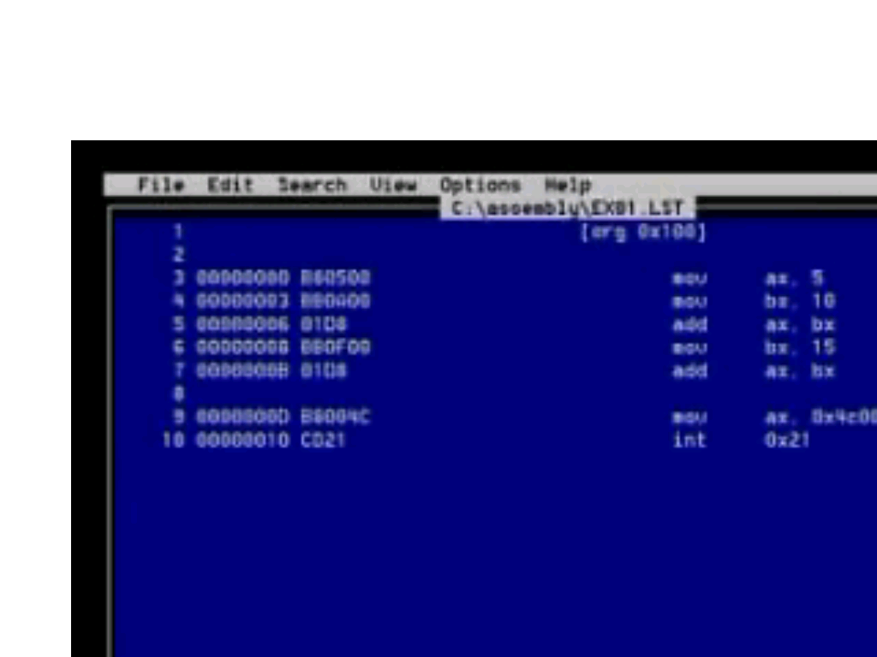
EX01.LST

Slide 24
Word Representation
4 Byte Word
Representation in Memory
MSB
LSB
Representation 1
Little Endian Notation
MSB
LSB
0 1 2 3
Representation 2
Big Endian Notation
LSB
MSB
0 1 2 3

